Slide 1
Computer Graphics – ST0275
EAFIT

Slide 2
Math for Computer Graphics
2D and 3D Reference Frames
Points and Vectors
Matrices
Parametric Representations

Slide 3
Coordinate reference frames
Cartesian Coordinates
Y axis
<x,y>
X axis

Slide 4
COORDINATE REFERENCE FRAMES
Polar Coordinates in the xy plane
Y axis
r
θ
X axis

Slide 5
Coordinate reference frames
Polar to Cartesian
X = r cos(θ)
Y = r sin(θ)
Cartesian to polar
r = sqrt(x² + y²)
θ = tan ⁻¹ (y/x)

Slide 6
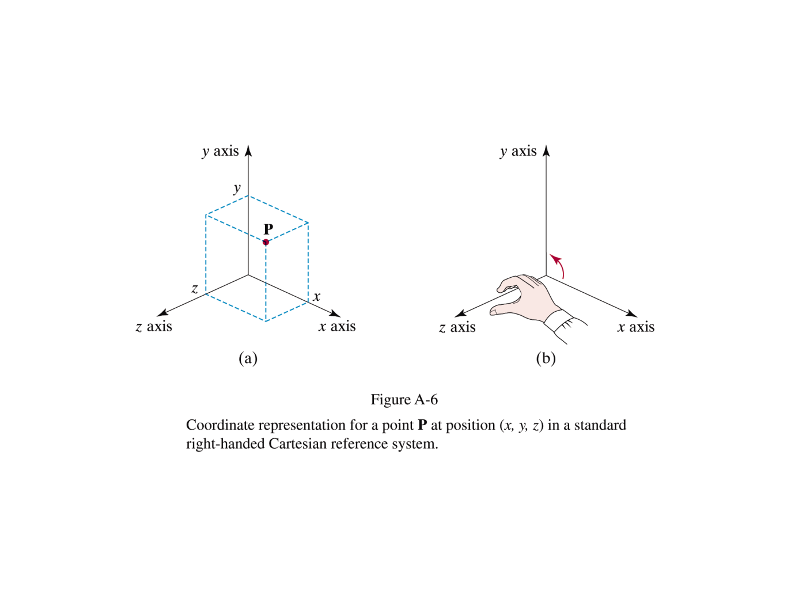
Coordinate reference frames
3D Cartesian Reference (right handed)

Slide 7
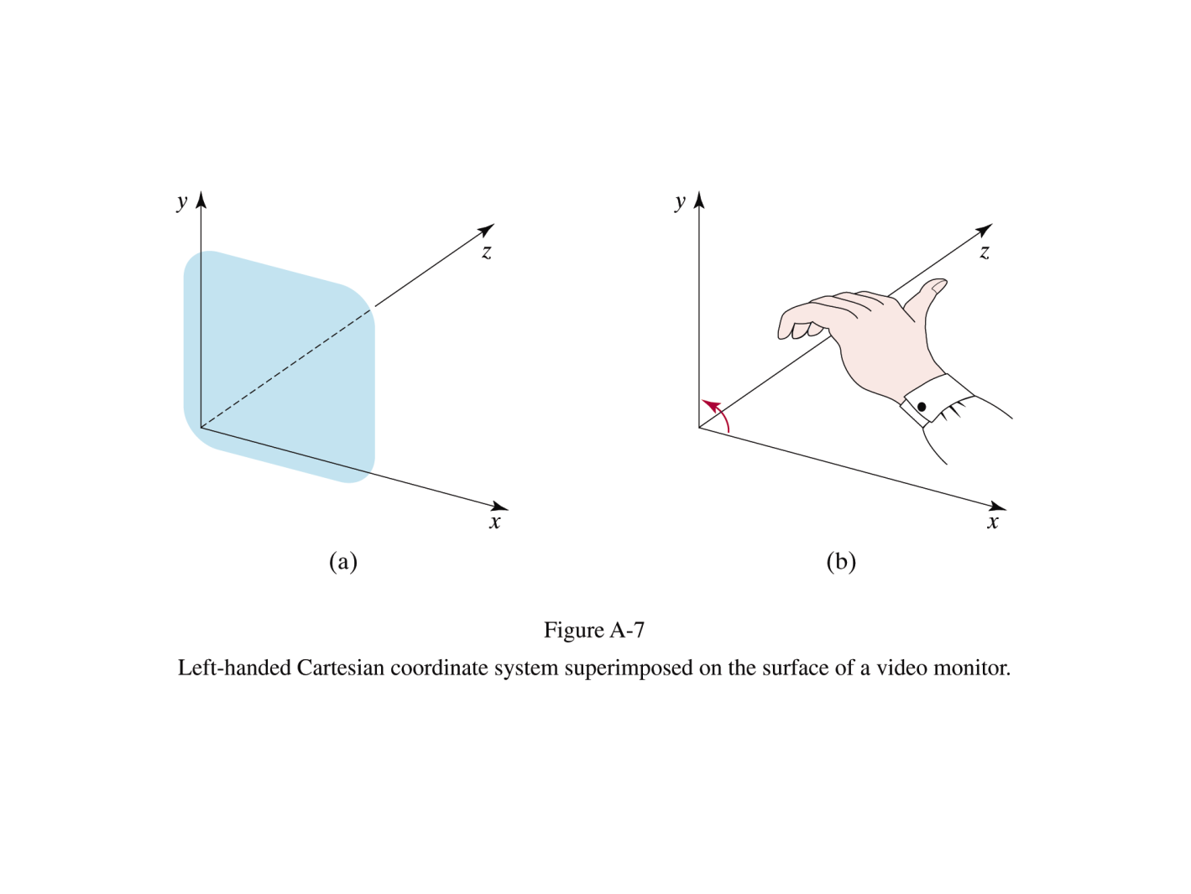
Coordinate reference frames
3D Cartesian Reference (left handed)

Slide 8
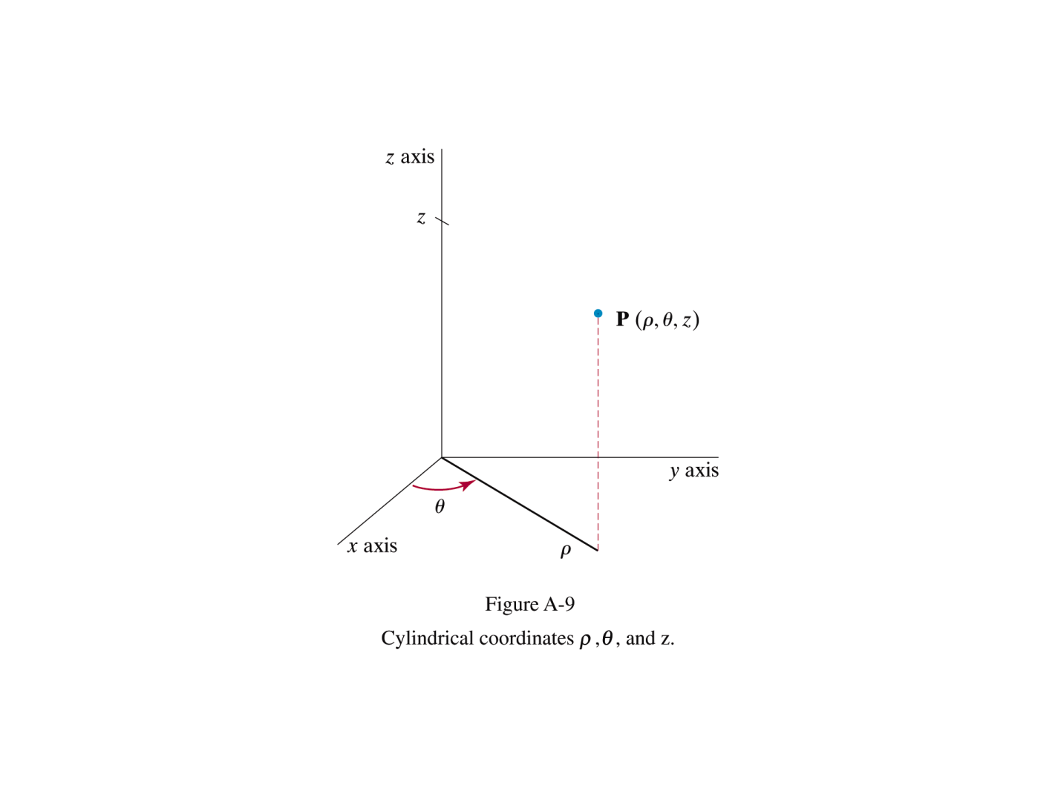
Coordinate reference frames
Cylindrical coordinates

Slide 9
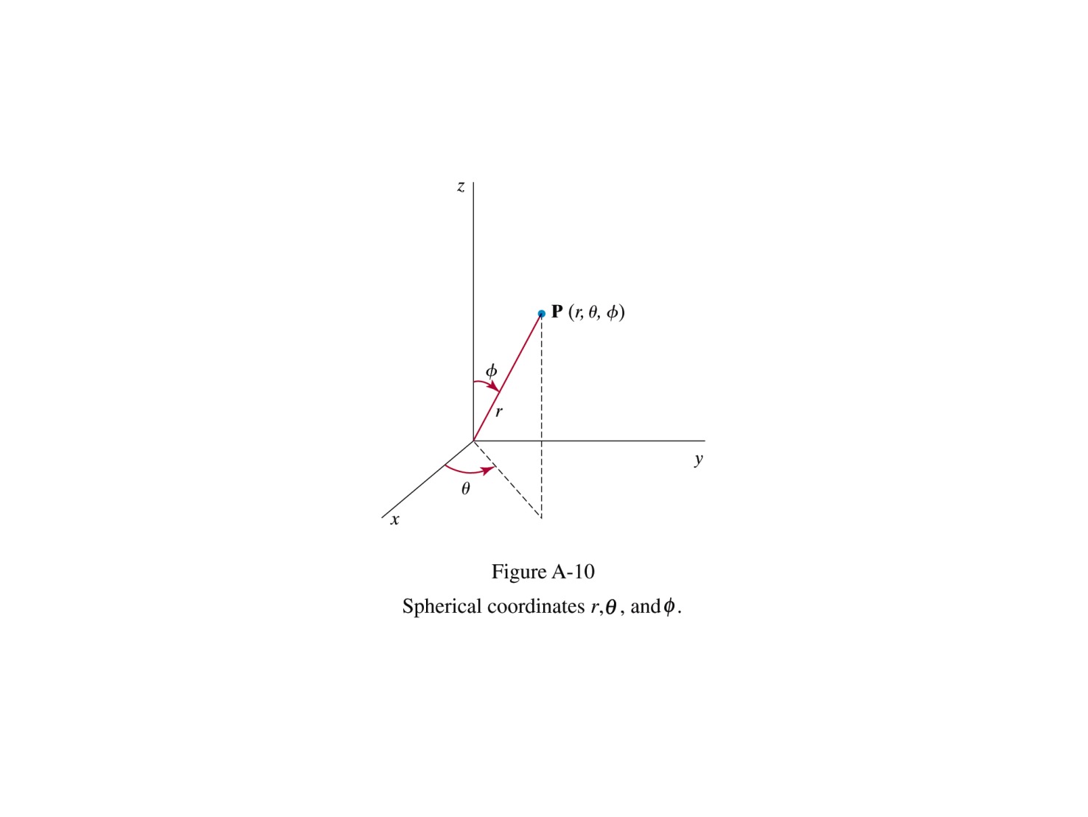
Coordinate reference frames
Spherical coordinates

Slide 10
Coordinate reference frames
Cylindrical to cartesian
X = ρ cos θ
Y = ρ sin θ
Z = z
Spherical to cartesian
X = r cos θ sin φ
Y = r sin θ sin φ
Ζ = r cos φ

Slide 11
Vectors
We can define a vector as the difference between two point positions.
V = P₂ – P₁
= (x₂ – x₁, y₂ – y₁)
= (V_{x}, V_{y})
A vector has magnitude and direction.
Does it have a starting point?
|V| = sqrt(V_{x}² + V_{y}²)

Slide 12
Vectors
In 3D
|V| = sqrt(V_{x}² + V_{y}² + V_{z}²)
Direction cosines
cos α = V_{x} / |V|
cos β = V_{y} / |V|
cos γ = V_{z} / |V|
cos ² α + cos ² β + cos ² γ = 1

Slide 13
Operations with vectors
Vector Addition
V₁ + V₂ = (V_{1x} + V_{2x}, V_{1y} + V_{2y}, V_{1z} + V_{2z})
Scalar-Vector multiplication
sV = (sV_{x}, sV_{y}, sV_{z})
Dot point (scalar product) of two vectors
V₁ . V₂ = |V₁||V₂|cos θ, 0 <= θ <= Pi
V₁ . V₂ = V_{1x}V_{2x} + V_{1y}V_{2y} + V_{1z}V_{2z}
Scalar product is commutative:
V₁ . V₂ = V₂ . V₁

Slide 14
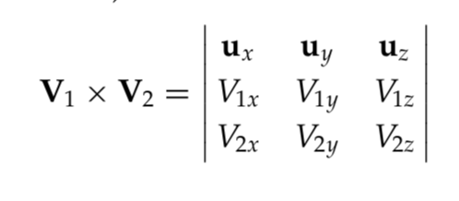
Operations with vectors
Vector (cross) product of two vectors
V₁ x V₂ = u|V₁||V₂|sin θ
u is a unit vector, orthogonal to V₁ and V₂.
Cross product is anti-commutative
V₁ x V₂ = - V₂ x V₁

Slide 15
Matrices
Matrix scalar multiplication:
Multiply each element m_{jk} by the scalar.
Matrix addition: for matrices with the same number of columns and rows:
c_{jk} = a_{jk} + b_{jk}
Matrix Multiplication:
C = AB
C_{ij} = a_{ik} b_{kj}, for k = 1 to n
A has m rows, n columns
B has n rows, o columns
C has m rows, o columns

Slide 16
Matrices
Transpose: exchange rows and columns
A^{T}
(M₁ M₂)^{T} = M₂^{T} M₁^{T}
Matrix inverse:
Defined for square matrices if the determinant of the matrix is nonzero.
M M⁻¹ = M⁻¹ M = I (Identity matrix)

Slide 17
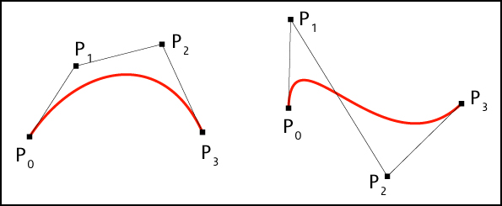
Parametric Representations
Line segment (covered last week)
Curve in space: how many parameters are needed?
Source: http://www.e-cartouche.ch/content_reg/cartouche/graphics/en/html/Curves_learningObject2.html

Slide 18
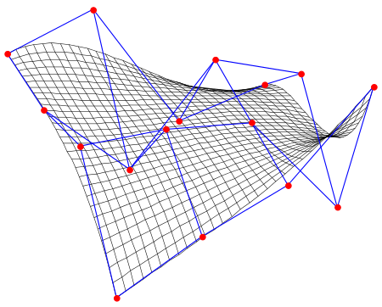
Parametric Representations
Surface in space: how many parameters are needed?
Source: http://en.wikipedia.org/wiki/B%C3%A9zier_surface

Slide 19
Reto
En la casa:
Clase Point3: x, y, w
Clase Point4: x, y, z, w
Clase Matrix3x3
Static: times (Matrix3x3, Point3): Point3
Static: times(Matrix3x3, Matrix3x3): Matrix3x3
Clase Matrix4x4
Static: times (Matrix4x4, Point4): Point4
Static: times (Matrix4x4, Matrix4x4): Matrix4x4
Clase Vector4: x, y, z
Static: crossProduct (Vector4, Vector4): Vector4
Static: dotProduct (Vector4, Vector4): double
Magnitude(): double
Normalize()

Slide 20
Reto
En la casa:
Clase: EcParSegReg: x1, y1, x2, y2
Static: solve(epsr1, epsr2): u1, u2
Leer la descripción de un objeto y dibujarlo (Por ejemplo: la casita)
Clase Edge: point1 (Point2), point2

Slide 21
La casita
5
100 100
200 100
200 200
150 250
100 200
6
0 1
1 2
2 3
3 4
4 0
2 4

Slide 22
El gancho de ropa
5
40 20
120 20
80 40
80 60
60 60
5
0 1
1 2
2 0
2 3
3 4

Slide 23
Credits
Images from Hearn & Baker textbook (Computer Graphics with OpenGL, 3rd Ed.)
Reading: H&B Appendix A. pp 814 – 818, 821- 824).

